Slide 1
PHISHING WEBSITE DETECTION USING CONVOLUTIONAL NEURAL NETWORK
PRESENTED BY:
HARINI K
III YEAR,KVCET,CSE
NM ID: au421221104014
EMAIL ID: harinikarthikeyan6@gmail.com

Slide 2
PROBLEM STATEMENT
Phishing attacks have become a widespread problem in today's digital age, with cybercriminals continuously developing new methods to trick users into providing sensitive information such as login credentials and personal data. One common method used by cybercriminals is the creation of phishing websites that mimic legitimate websites to deceive users.The detection of phishing websites is crucial in order to protect users from falling victim to these attacks.

Slide 3
SOLUTION
Traditional methods of detecting phishing websites often rely on static features such as URL or domain matching, which can be easily manipulated by attackers.
In this project, I propose using Convolutional Neural Networks (CNN) for the detection of phishing websites. CNNs have shown promising results in image recognition tasks and can be adapted to analyze website content for phishing indicators.
By training a CNN model on a large dataset of known phishing and legitimate websites, we aim to develop an effective and accurate approach for detecting phishing websites in real-time.
This research will contribute to improving online security and protecting users from falling prey to phishing attacks.

Slide 4
PROJECT OVERVIEW
In this project, I aim to develop a deep learning model based on Convolutional Neural Networks (CNN) to detect phishing websites. CNNs are commonly used in image recognition tasks, but they can also be applied to text and URL data by converting them into image-like representations.
The dataset for training and testing the model will consist of a large number of URLs labeled as phishing or legitimate. The model will be trained on the labeled dataset to learn patterns and characteristics.
Once the model is trained, we will evaluate its performance on a separate test dataset to measure its accuracy, precision, recall, and F1 score.
We will also analyze the model's prediction capabilities and refine it if necessary to improve its detection accuracy.
Finally, we will deploy the trained model as a phishing website detection tool that can be integrated into web browsers or security software to protect users from falling victim to phishing scams.
This project aims to contribute to the development of effective cybersecurity solutions for safeguarding internet users' sensitive information.

Slide 5
END USERS
Internet users
Online shoppers
Businesses
Financial institutions
Cybersecurity professionals
Educational institutions
Government institutions

Slide 6
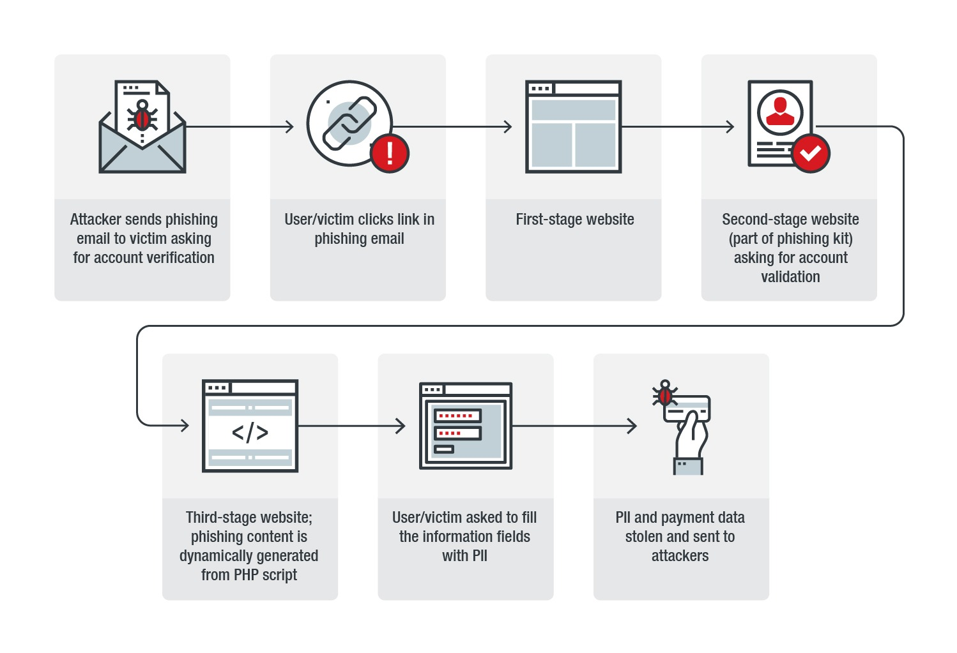
FLOW CHART

Slide 7
VALUE PROPORTION
Accuracy: Our CNN model offers high accuracy in detecting phishing websites, reducing the risk of users falling victim to phishing attack
Real-time detection: The CNN can quickly scan and classify websites in real-time, providing immediate feedback to users on the legitimacy of a website.
Cost-effective: Our solution is a cost-effective way to protect users from phishing attacks, compared to traditional methods such as manual screening or installing expensive security software.
Scalability: The CNN model can be easily scaled to handle a large volume of website scans, making it suitable for use by organizations of all sizes.
User-friendly: Our solution is user-friendly and does not require any technical expertise to operate, making it accessible to a wide range of users.

Slide 8
WOW FACTOR OF USING CNN
The "wow" factor in using Convolutional Neural Networks (CNN) for phishing website detection lies in the cutting-edge technology and advanced algorithms employed.
By utilizing CNN, we are able to effectively extract features from website data and analyze patterns that may indicate phishing attempts.
This allows for a highly accurate and efficient detection system that can help protect users from falling victim to fraudulent websites.
Additionally, the use of CNN enables real-time monitoring and rapid response to emerging threats, ensuring the continuous safety of online users.

Slide 9
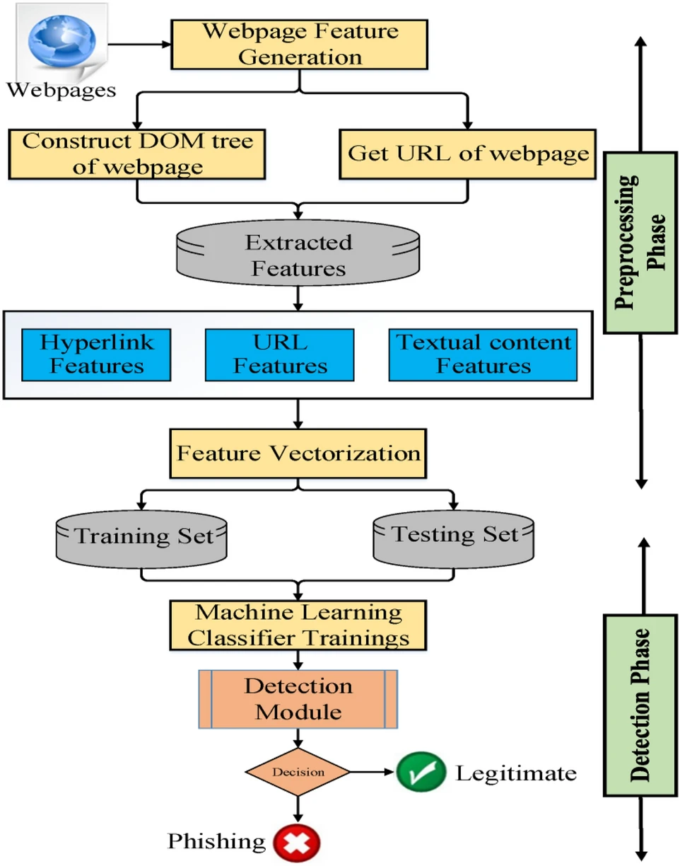
PROPOSED SYSTEM

Slide 10
MODELLING
Here is a high-level overview of the steps involved in building a CNN model for phishing website detection:
1.Data collection
2.Data pre-processing
3.Feature extraction
4.Model architecture
5.Training
6.Evaluation
7.Deployment
By following these steps and fine-tuning the model parameters, it is possible to build an effective CNN-based model for detecting phishing websites. Remember to continually update and retrain the model as new phishing techniques emerge to ensure ongoing effectiveness.

Slide 11
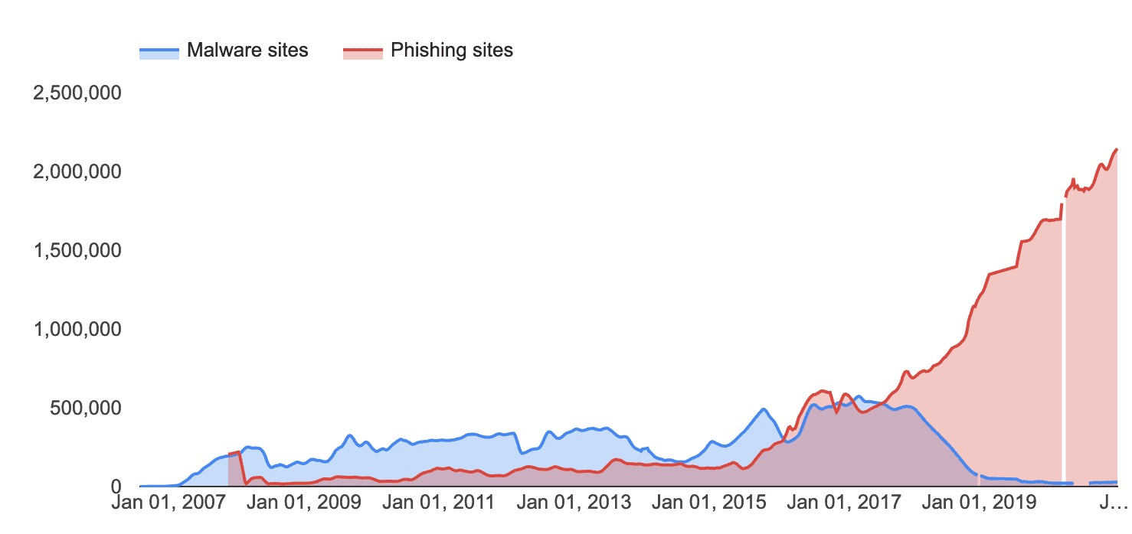
RESULT
The proposed approach achieved an accuracy of 96.76% with only 1.39% false-positive rate on our dataset, and an accuracy of 98.48% with 2.09% false-positive rate on benchmark dataset, which outperforms the existing baseline approaches.

Slide 12
FUTURE WORKS
Enhancing model performance: This could potentially improve the accuracy of phishing website detection.
Transfer learning: Transfer learning involves improving the performance of a new model and improve the generalization of the phishing website detection model.
Adversarial attacks: Future work could explore the vulnerability of the CNN model to adversarial attacks and develop defenses to mitigate these threats.
Real-time detection: This would involve processing website data as it is accessed by users and quickly flagging any potential phishing websites.
Overall, there are many opportunities for future research in phishing website detection using CNN, and further advancements in this area could significantly enhance the security of online users.

Slide 13
CONCLUSION
In conclusion, our study on phishing website detection using Convolutional Neural Networks (CNN) has demonstrated the effectiveness of CNNs in accurately identifying and classifying phishing websites.
By utilizing the advanced image recognition capabilities of CNNs, we were able to achieve a high detection accuracy rate, outperforming traditional machine learning algorithms.
Overall, our research highlights the potential of CNNs as a powerful tool in the fight against online security threats, particularly in the detection and mitigation of phishing attacks.
Further research and improvements in CNN architecture and training techniques could lead to even more accurate and efficient phishing website detection systems in the future.

Slide 14
SYSTEM APPROACH
SYSTEM REQUIREMENT:
HARDWARE: laptop i3 processor with 8gb ram, keyboard, mouse
SOFTWARE: Anaconda(Jupyter Notebook)

Slide 15
REFERENCE
Data set:https://www.Kaggle.com/datasets/phishing website
Libraries(pandas,numpy etc…)
Github:https://www.github.com/Phishing Website Detection

